Slide 1



Department of Computer Science and Engineering
ICU PATIENT RISK LEVEL MONITORING SYSTEM USING SUPERVISED LEARNING APPROACHES
HARESH KUMAR P (211420104088)
ELANGO K (211420104071)
EMMANUEL JONATHAN E (211420104073)
Coordinator:
Dr. N. PUGAZHENDI M.E., Ph.D.,
Project Guide:
Dr. V SATHYA PREIYA M.E., Ph.D.,

Slide 2
Abstract
In the current situation, where the healthcare industry is grappling with challenges posed by various diseases and the increasing demand for ICU beds, an intelligent monitoring system capable of accurately assessing patient risk levels can significantly enhance patient care and resource allocation. For clinicians, the real-time interpretation of data and decision-making is a challenging task.
With the rising complexity of healthcare, the need for advanced monitoring systems in intensive care units (ICUs) becomes paramount.
Machine Learning (ML) techniques in ICUs are making headway in the early detection of high-risk events due to increased processing power and freely available data such as heart rate, Systolic blood pressure, Diastolic blood pressure, Body Mass Index(BMI), Respiratory Rate etc.
The ICU patient risk level monitoring system plays a crucial role in improving patient safety, optimizing resource allocation, and enhancing clinical decision-making in intensive care settings. By continuously monitoring and analyzing patient data, it provides valuable insights that help healthcare providers intervene promptly and prevent adverse outcomes.

Slide 3
Objective of the Project
Its main objective is to contribute to the improvement of the quality of care by evaluating and analysing in-hospital environment and channelling the improvement actions proposed as a result of this analysis.
→
Minimizing the ratio of patients to staff
→
Monitoring patient health
→
Keeping an eye on the patients round-the-clock
→
Assessing patient's risk levels and informing physicians of any changes

Slide 4
Literature Survey
YEAR | TITLE AND JOURNAL | AUTHOR | DESCRIPTION | TECHNIQUE | FUTURE ENHANCEMENTS
2016 | Mortality Prediction in the ICU . | Joon Lee, Joel A. Dubin and David M. Maslove | Patients admitted to the ICU suffer from critical illness or injury and are at high risk of dying.The risk of death can be approximated by evaluating the severity of a patient’s illness as determined by important physiologic, clinical, and demographic determinants. | Clustering | It requires detailed data on deaths by age group, data that are often not available in developing countries.
2018 | Dynamic mortality prediction using machine learning techniques for acute cardiovascular cases . | Oleg Metskera, Sergey Sikorsky. | Study of model components and their connection is developed. The dynamic data extracted directly from medical information system were analysed, that is very close to the real process. | Unsupervised learning | Handling time-series data with multiple, irregular, abnormal values is difficult.

Slide 5
Literature Survey
YEAR | TITLE AND JOURNAL | AUTHOR | DESCRIPTION | TECHNIQUE | FUTURE ENHANCEMENT
2021 | Mortality Prediction in ICU Patients Using Machine Learning Models. | Akhyar Ali Khan, Rehan Liaqat. | Effective utilization of limited intensive care unit (ICU) allocations is a challenging task for medical experts to save precious human livesThis paper presents two mortality prediction models using the support vector machine (SVM) and linear discriminant analysis. | Reinforcement learning | The patterns that may be present in the missing clinical data are not thoroughly considered.
2022 | Identifying Predictors of COVID-19 Mortality Using Machine Learning. | Tsz-Kin Wan, Rui-Xuan Huang. | Data from 14,876 COVID-19 patients were input into the machine learning model for risk-level mortality prediction, with the predicted risk level ranging from 0 to 1. Of the three models used in the experiment. | Random Forest Algorithm | The models compared to Fine Gray models to generate risk predictions for fracture and competing mortality.

Slide 6
Problem Statement
Over 120 million individuals are affected by the coronavirus illness (COVID-19), which is a serious global public health epidemic that has killed over 2 million people in 199 nations. In March 2020, the World Health Organization (WHO) classified the COVID-19 outbreak as a pandemic. Since then, the front-line nurses have had to contend with a number of difficulties, such as a severe nursing shortage, a lack of medical supplies, and a range of psychological issues like burnout and infection fear. These discoveries will help nurses fight the pandemic more resiliently as the disease continues to evolve. In our situation, there will be less interaction between the medical staff and the patients, preventing the transmission of infection. In the event of a pandemic outbreak, our technology will act as a barrier between the nurse and the afflicted patient. For example, Disease X, as classified by the World Health Organization (WHO), is a fictitious pathogen that has the potential to trigger a worldwide health emergency. Healthcare workers in the UK are bracing for a possible new pandemic called "Disease X," which has the potential to kill 20 times as many people as COVID-19. It is possible that Disease X will kill up to 50 million people.

Slide 7
Existing system
The common challenges faced in existing system are as follows:
→
Clinical risk prediction based on Electronic Health Records (EHR) can assist doctors in better judgment and can make sense of early diagnosis. However, the prediction performance heavily relies on effective representations from multi-dimensional time series EHR data.
→
Existing solutions usually focus on temporal features or inherent relations between clinical event variables or extract both information in two separate phases. This usually leads to insufficient patient feature information and results in poor prediction performance.
→
Moreover, existing methods based on Heterogeneous Graph Neural Networks usually require the manual selection of proper Meta-Paths. To solve these problems, we propose the Time-aware Context-Gated Graph Attention Network (T-Context GGAN).
→
Their process required a lot of computational power; they didn't deploy the model, and their accuracy was much lower than ours.

Slide 8
Proposed System
→
ICU patient risk level monitoring system utilizing supervised learning techniques. This system would assist healthcare professionals in assessing and monitoring the risk levels of patients in intensive care units (ICUs) in real-time.
→
Gather a comprehensive dataset consisting of patient demographics, vital signs, laboratory results, medical history, medication records, and other relevant variables for ICU patients. This dataset will serve as the input for training and validating the supervised learning models.
→
We Implement a system that continuously collects real-time patient data from the ICU, applies the trained models, and provides risk level predictions for individual patients. This system can generate alerts or it’s important to note that the specific implementation details and choice of supervised learning algorithms may vary depending on the available data, healthcare institution, and desired performance objectives
→
The proposed system provides a high-level overview of the key components involved in developing an ICU patient risk level monitoring system using supervised learning techniques. Notifications to healthcare professionals when a patient's risk level exceeds a predefined threshold, enabling early intervention and timely medical attention

Slide 9
Software used
Software Requirements:
Python Version 3.7 or Later
HTML
CSS
JavaScript
Django
MySQL
VS Code
Anaconda With Juypter Notebook
Hardware Requirements:
Processor : Intel i3/AMD Ryzen3
Hard disk : minimum 10 GB
RAM : minimum 2 GB

Slide 10
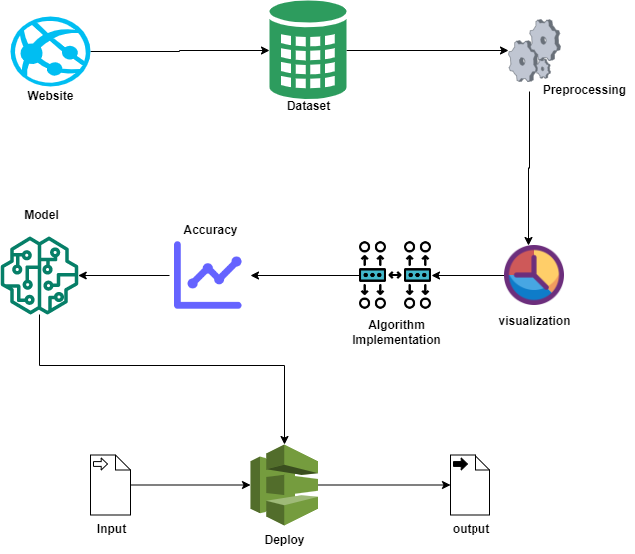
Architecture Diagram

Slide 11
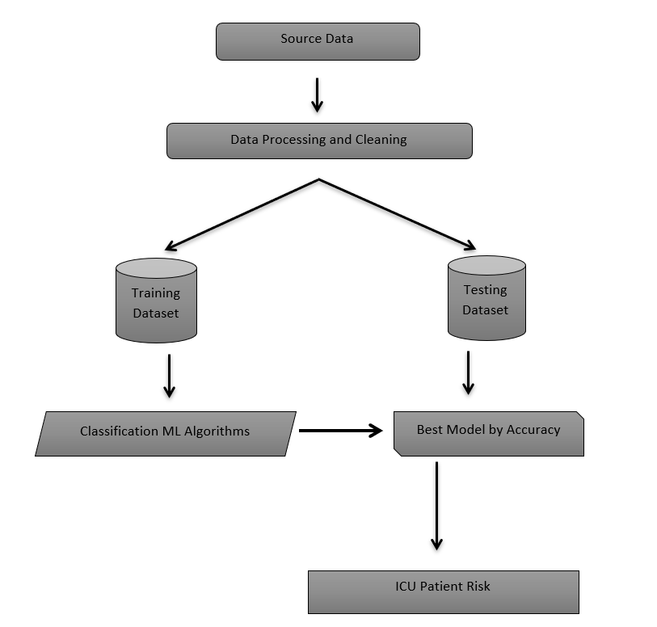
System Design – Work Flow Diagram

Slide 12
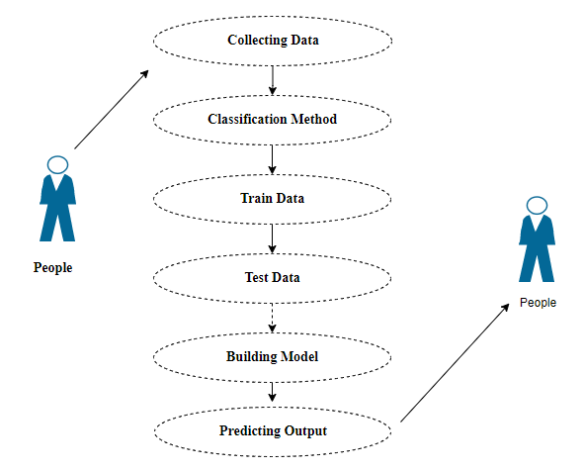
System Design – Use Case Diagram

Slide 13
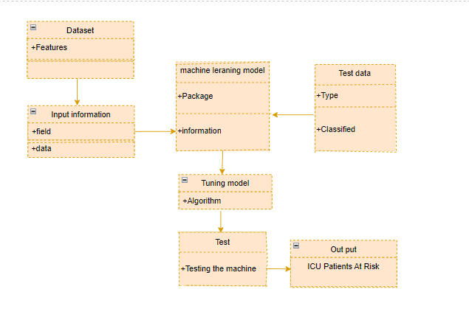
System Design – Class Diagram

Slide 14
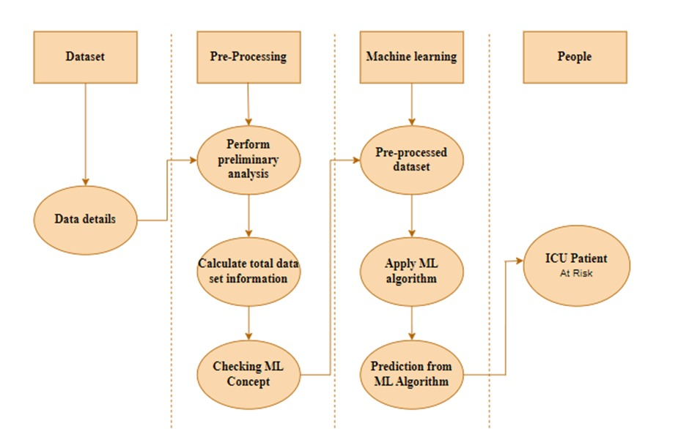
System Design –ActivityDiagram

Slide 15
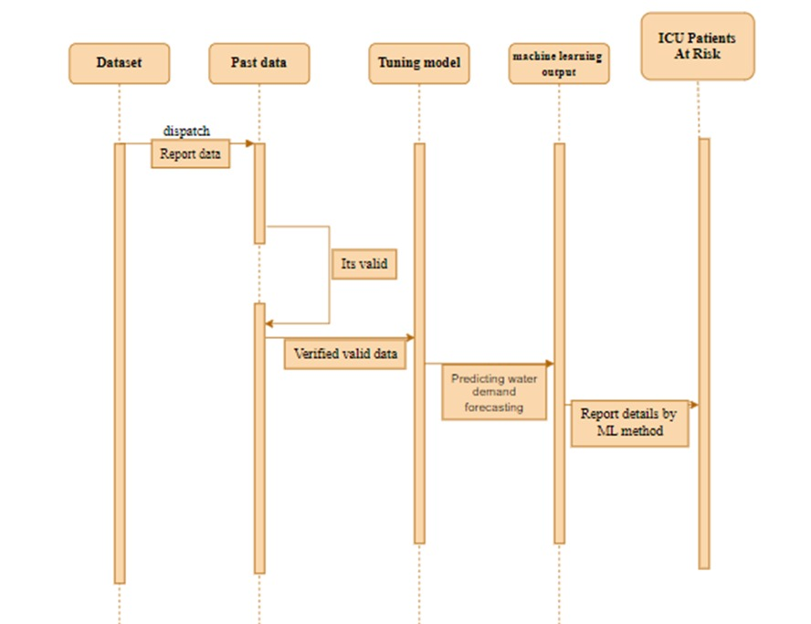
System Design –Sequence Diagram

Slide 16
Module
This project uses the following Modules like :
Data Pre-processing
Data visualization
Algorithm implementation
K- Nearest Neighbour’s Classifier
Cat Boost Classifier
Random Forest Classifier
Deployment

Slide 17
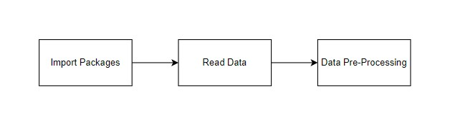
Module Description
Data Pre-Processing:
Validation techniques in machine learning are essential for obtaining an unbiased evaluation of a model's fit on a dataset.
They help identify missing values, duplicate values, and data types, which can lead to biased evaluations. Data collection, analysis, and addressing data content, quality, and structure can be time-consuming.
Python's Pandas library focuses on missing values and can quickly clean data, allowing more time for exploration and modeling.
Understanding the types of missing data from a statistics perspective is crucial for dealing with them and implementing imputation and detailed statistical approaches.
Variable identification with Uni-variate, Bi-variate, and Multi-variate analysis can help identify missing values and improve model performance.

Slide 18
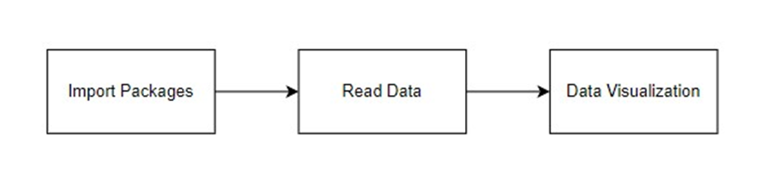
Module Description
Data visualization:
Data visualization is a crucial skill in applied statistics and machine learning, providing a qualitative understanding of data.
It aids in exploring and understanding a dataset, identifying patterns, corrupt data, and outliers. With a little domain knowledge, data visualizations can express key relationships in visceral plots and charts, rather than measures of association or significance.
Understanding different types of plots in Python is essential for better understanding one's own data.
GIVEN INPUT EXPECTED OUTPUT
Input : Data
Output : Visualized Data.

Slide 19
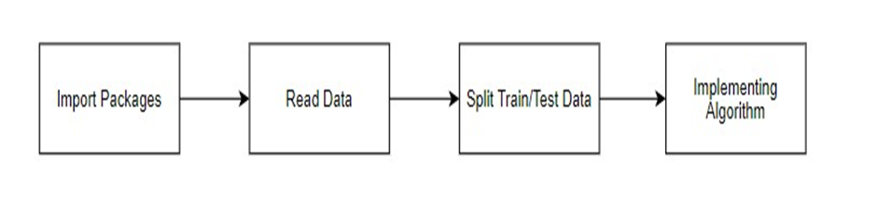
Module Description
KNN Classifier:
The KNN algorithm can compete with the most accurate models because it makes highly accurate predictions. Therefore, you can use the KNN algorithm for applications that require high accuracy but that do not require a human-readable model.
The quality of the predictions depends on the distance measure. It is a simple, supervised machine learning algorithm that can be used to solve both classification and regression problems.
It's easy to implement and understand, but has a major drawback of becoming significantly slows as the size of that data in use grows. Doesn't work well with a large dataset

Slide 20
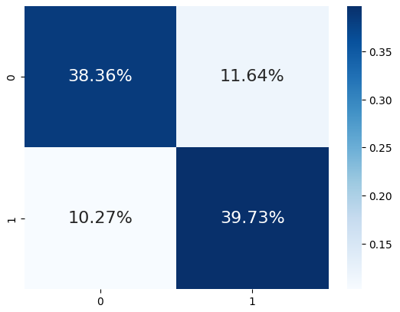
KNN CLASSIFIER
The Accuracy Score Of K neighbors Classifier Is : 78.08219178082192
The Hamming Loss Of K neighbors Classifier Is : 21.91780821917808
The Precision Score Of K neighbors Classifier Is : 77.33333333333333
The Confusion Matrix Score Of K neighbors Classifier:
[[56 17]
[15 58]]

Slide 21
Module Description
Cat Boost Classifier:
The goal of training is to select the model py, depending on a set of features x{i}xi, that best solves the given problem (regression, classification, or multi-classification) for any input object.
Cat Boost is based on gradient boosted decision trees. During training, a set of decision trees is built consecutively. Each successive tree is built with reduced loss compared to the previous trees.
The number of trees is controlled by the starting parameters. To prevent overfitting, use the overfitting detector. When it is triggered, trees stop being built.

Slide 22
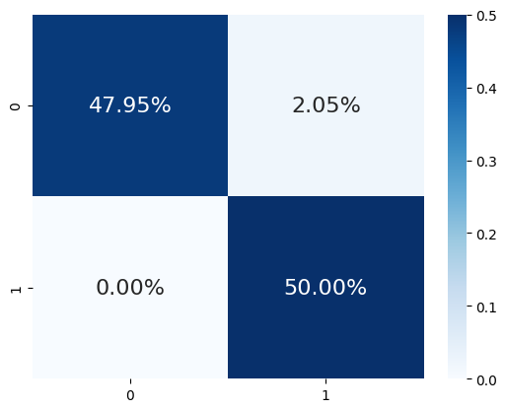
CAT BOOST CLASSIFIER
The Accuracy Score Of Catboost Classifier Is : 97.94520547945206
The Hamming Loss Of Catboost Classifier Is : 2.054794520547945
The Precision Score Of Catboost Classifier Is : 96.05263157894737
The Confusion Matrix Score Of Catboost Classifier:
[[70 3]
[ 0 73]]

Slide 23
Module Description
Random Forest Classifier:
Random Forest is an ensemble machine learning algorithm that combines the predictions of multiple decision trees, each created using different subsets of data and features.
This approach enhances prediction accuracy, reduces overfitting, and provides valuable insights into feature importance.
It's a versatile and widely used tool in machine learning for tasks such as classification and regression, particularly suited for handling complex datasets and improving overall model robustness.

Slide 24

RANDOM FOREST CLASSIFIER
The Accuracy Score Of Random Forest Classifier Is : 99.31506849315068
The Hamming Loss Of Random Forest Classifier Is : 0.684931506849315
The Precision Score Of Random Forest Classifier Is : 98.64864864864865
The Confusion Matrix Score Of Random Forest Classifier:
[[72 1]
[ 0 73]]

Slide 25
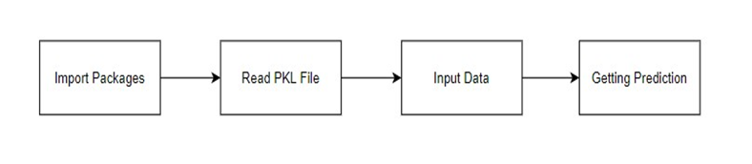
Module Description
Deployment:
Deploying the model predicting output In this module the trained machine learning model is converted into pickle data format file (.pkl file) which is then deployed for providing better user interface and predicting the output of heart attack.

Slide 26
Testing /Performance Evaluation / Results
TEST CASE ID | TESTCASE / ACTION TO BE PERFORMED | EXPECTED RESULT | ACTUAL RESULT | PASS/ FAIL
1. | Selecting “Sign up” Button | Display Sign up Page | Displays Sign up Page | Pass
2. | Selecting “Submit” Button | It Generates new user Data | It Generates new user Data | Pass
3. | Click The “Already Have a Account” Button | It Displays The Login Page | It Displays The Login Page | Pass

Slide 27
Testing /Performance Evaluation / Results
TEST CASE ID | TESTCASE / ACTION TO BE PERFORMED | EXPECTED RESULT | ACTUAL RESULT | PASS/ FAIL
4. | Click the "Login" button after entering your credentials. | Display Home Page | Displays Home Page | Pass
5. | Selecting “Deployment” button In Menu Bar | Display the form for predicting risk. | Displays the form for predicting risk. | Pass
6. | Once the patient's vitals have been entered, click the submit button | Display its risk level and notifies the physicians | Displays its risk level and notifies the physicians | Pass

Slide 28
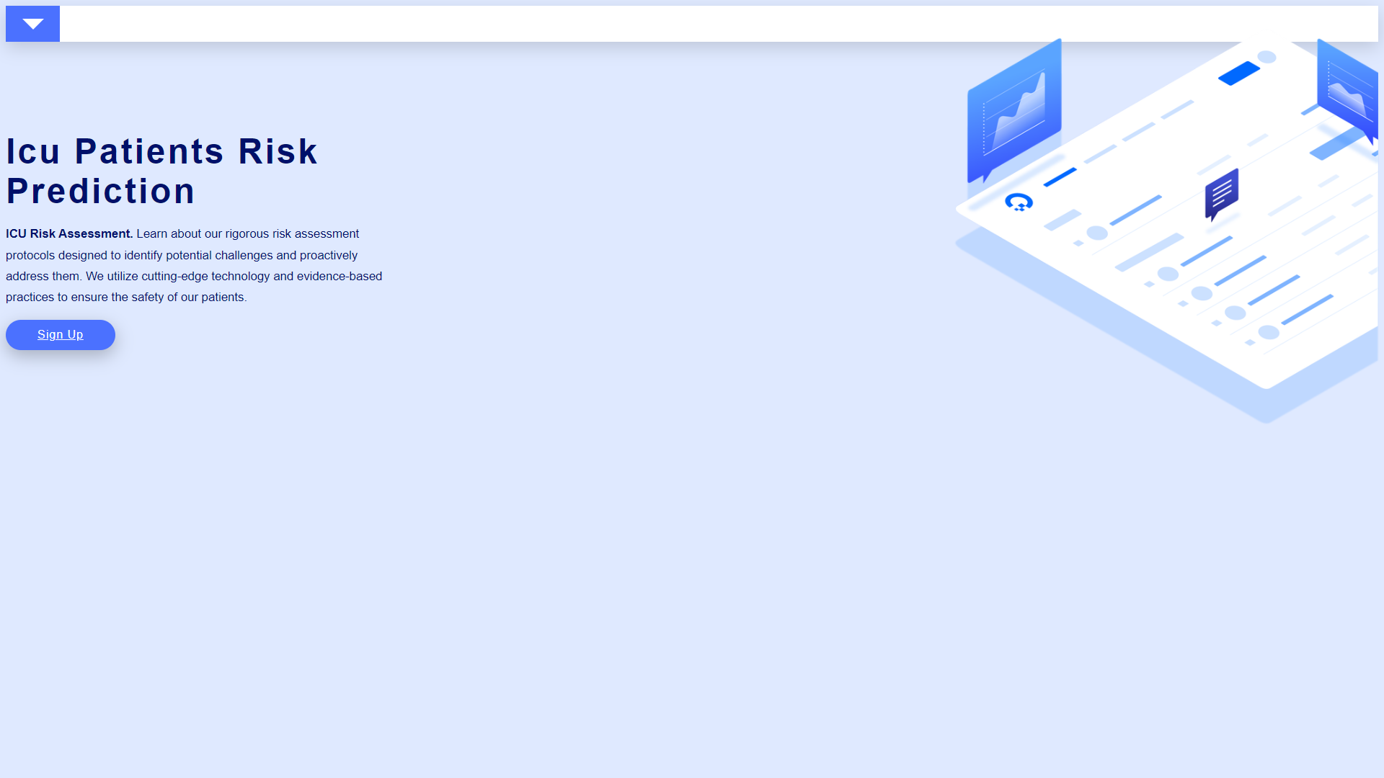
Screen Shots
Fig :Display Page

Slide 29


Screen Shots
Fig : Signup And Login Page

Slide 30

Screen Shots
Fig : Home Page

Slide 31
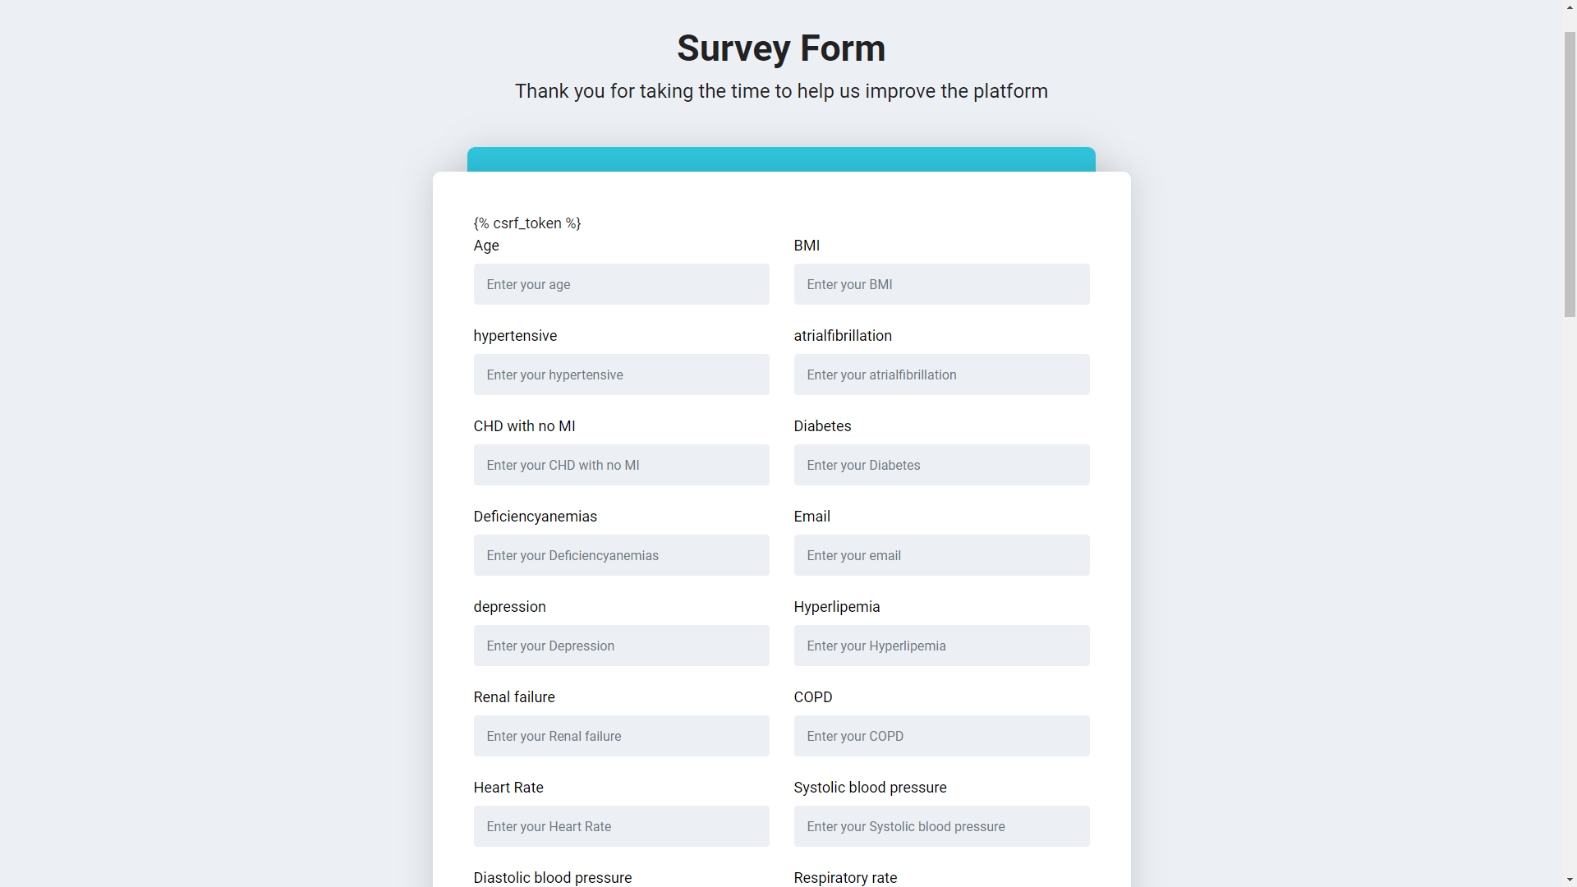
Screen Shots
Fig : Deployment Page

Slide 32
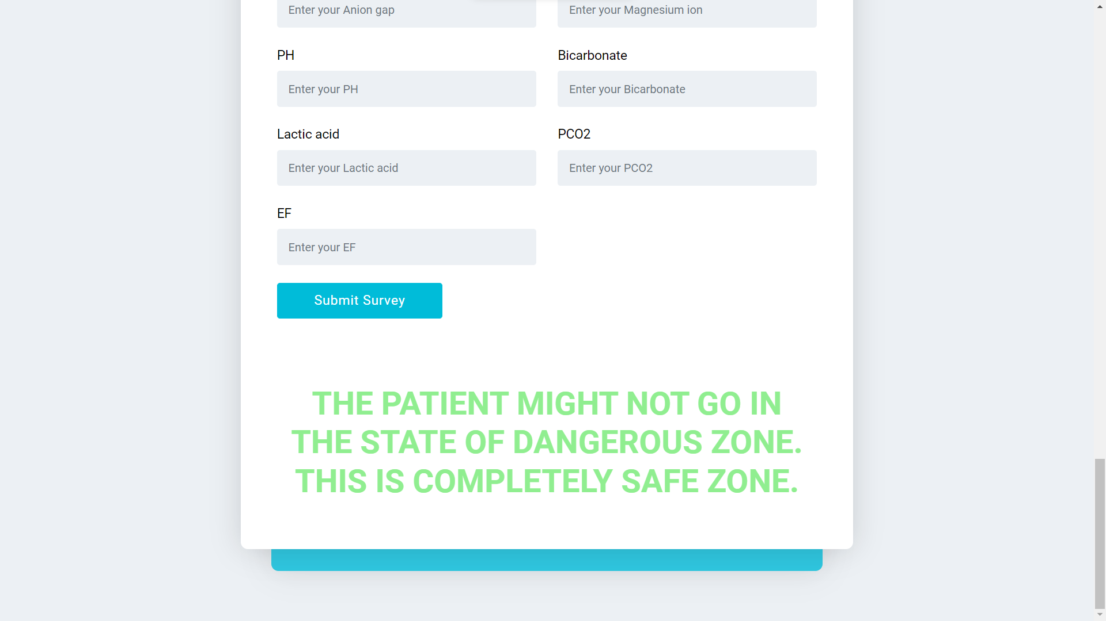
Screen Shots
Fig : Result Page

Slide 33
Conclusion
Our system provides the analytical process started from data cleaning and processing, missing value, exploratory analysis and finally model building and evaluation. The best accuracy on patient test set of higher accuracy score algorithm will be find out. Through continuous refinement and adaptation, such systems hold promise in improving resource allocation, reducing medical errors, and ultimately saving lives in critical care settings. The founded one is used in the application which can help to find the Hospital Mortality.
The application aims to reduce hospital staff working hours by monitoring patient stats and alerting doctors if they are at risk. The system will be optimized for seamless integration into clinical practice, benefiting patients and caregivers. The COVID-19 pandemic has affected over 120 million people, with the World Health Organization classifying it as a pandemic in March 2020.
This has led to challenges for front-line nurses, including nursing shortages, lack of medical supplies, and psychological issues like burnout and infection fear. The application aims to help nurses fight the pandemic more resiliently by reducing interaction between medical staff and patients, preventing infection transmission. In the event of a pandemic outbreak, the technology will act as a barrier between nurses and patients. The UK is bracing for a possible new pandemic called "Disease X" potentially causing up to 50 million deaths.

Slide 34
Feature Enhancement
Shall host the platform on online servers to make it accessible worldwide.
To optimize the work to implement in the IOT system.
To develop an application for mobile devices that allows family and friends to instantly check on a patient's vitals.
The above mentioned are the future enhancements that can be done to make this project much more dynamic.

Slide 35
SDG GOALS
GOAL 3: Good Health and Well Being: Everyone's health and well-being are guaranteed by the ICU Patient Risk Level Monitoring System, regardless of age.
GOAL 8: Decent Work and Economic Growth: The ICU Patient Risk Level Monitoring System encourages fair labor for all, complete and productive employment, and consistent, inclusive, and sustainable economic growth.
GOAL 9: Industry innovation and infrastructure: The Monitoring System for ICU Patient Risk Level Create a robust infrastructure, encourage equitable and sustainable industrialization, and cultivate creativity.
GOAL 17: Partnerships for the goals: The System for Monitoring ICU Patient Risk Level enhance the Global Partnership for Sustainable Development's implementation strategies and objectives.

Slide 36
Reference Papers
[1] Time-Aware Context-Gated Graph Attention Network for Clinical Risk Prediction
[2] AI-Enhanced Intensive Care Unit: Revolutionizing Patient Care with Pervasive Sensing
[3] An Agent-Based Modeling and Virtual Reality Application Using Distributed Simulation: Case of a COVID-19 Intensive Care Unit
[4] Evaluating Risk-Adjusted Hospital Performance Using Large-Scale Data on Mortality Rates of Patients in Intensive Care Units: A Flexible SemiNonparametric Modeling Approach
[5] Risk assessment of ICU patients through deep learning technique: A big data approach.
[6] Machine Learning and Decision Support in Critical Care.
[7] R. Bosnian, H. Oudemans van Straaten, and D. Zandstra, "The use of intensive care information”.

